Slide 1
Oceans and Us

Slide 2
Resources
The ocean has many resources that are used everyday by people all over the world.
  Oxygen
  Energy
  Food
  Oxygen, energy, and food are only a few resources. Can you think of any others?

Slide 3
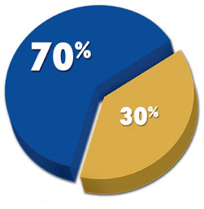
Oxygen and Nature
The oceans produces 70 percent of the Earth’s oxygen
The ocean also influences the Earth’s weather
The ocean is the cause of most of the Earth’s rainfall

Slide 4
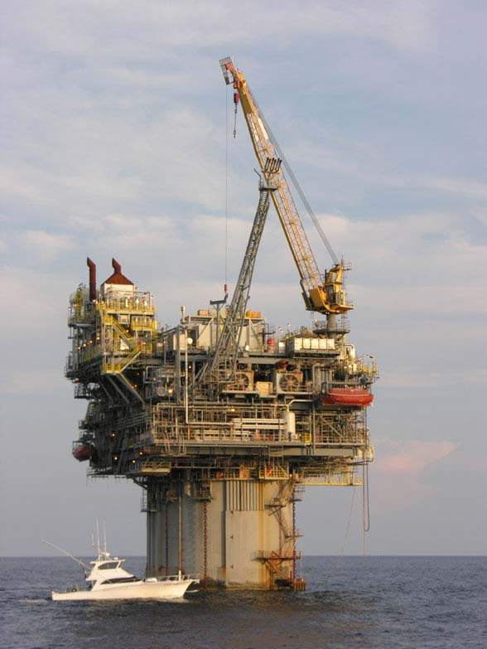
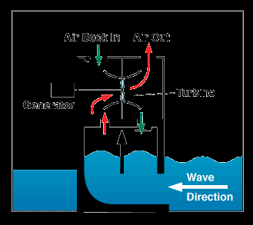
Energy
The ocean produces a variety of energy
  Oil and Fossil Fuels
  Wave Energy
  Tidal Energy

Slide 5
Food
A huge variety of fish, animals, plant life, and other minerals come from the oceans.
Different oceans have different species of each
Many countries rely completely on the ocean to provide food and nourishment

Slide 6
Recreation
The ocean provides people all over the world with a way to pass time.
  Fishing
  Surfing
  Scuba Diving
  Boating
  Can you think of any other activities people use the ocean for?

Slide 7
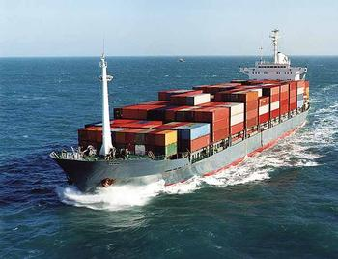
Transportation
The ocean is how many people get goods and materials from all over the world

